Slide 1





A CASE STUDY ON SYNTHETIC FRAUD DETECTION
Student Name : Chavan Khushi Yogesh
Email id : chavankhushi1801@gmail.com
Guide: Mr. Deepneel Majumdar
Disclaimer: The content is curated for educational purposes only.
Notes:
Slides: Prepare a short slide deck (10-12 slides) summarizing the project objectives, methodology, and key results.

Slide 2
Project Title
Synthetic Fraud Detection

Slide 3
Problem Statement
This project aims to develop a Synthetic Fraud Detection System by generating high-quality synthetic fraud datasets that mimic real-world fraud scenarios. The system will utilize generative models to create realistic yet diverse fraudulent and non-fraudulent transaction data. The objective is to enhance fraud detection accuracy by training machine learning models on synthetic data and evaluating their performance against traditional methods.

Slide 4
Proposed Solution
1.Data Collection & Preprocessing – Gather and preprocess real-world data while ensuring privacy.
2.Synthetic Data Generation – Use generative models to create diverse fraud and non-fraud data.
3.Model Training – Train machine learning models on synthetic data for fraud detection.
4.Evaluation – Compare performance with real data using precision, recall, and AUC-ROC.
5.Deployment – Implement and refine the system for real-world fraud prevention.
This approach enhances fraud detection while preserving data privacy.

Slide 5
Objective
Enhance fraud detection accuracy by training machine learning models on synthetic data.
Preserve data privacy by reducing reliance on sensitive real-world datasets.
Improve model robustness by generating diverse and realistic fraud patterns.
Validate effectiveness by comparing synthetic-trained models with traditional methods.

Slide 6
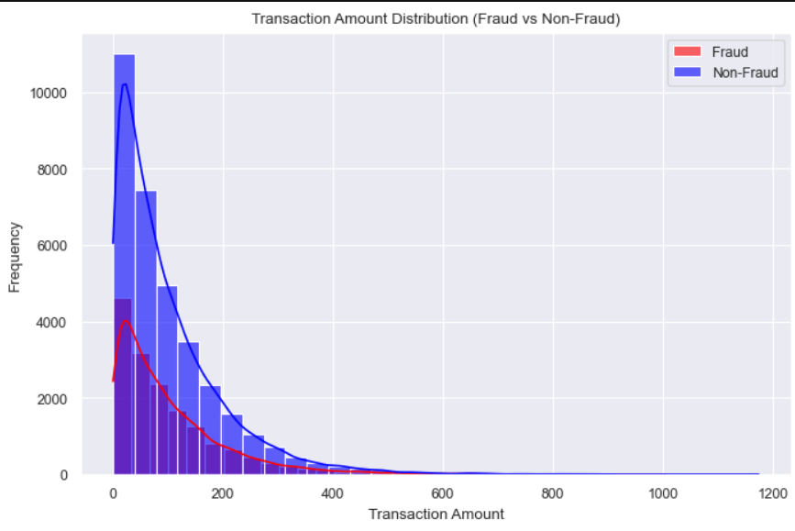
Output Screenshot

Slide 7
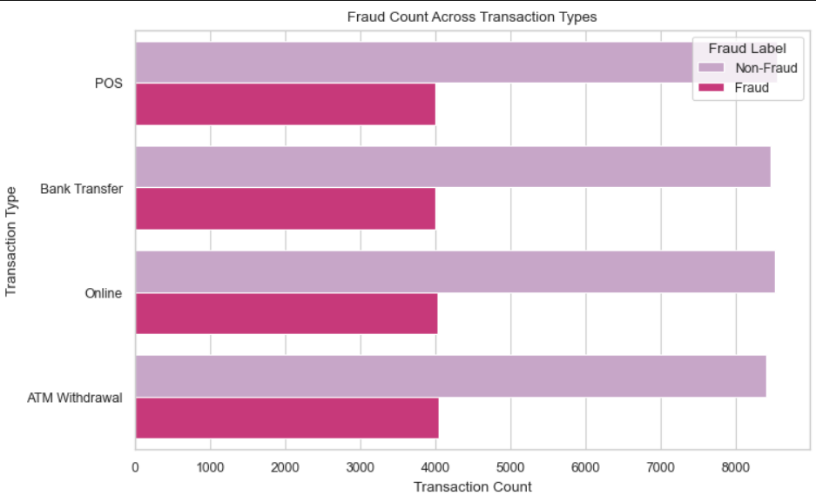

Slide 8
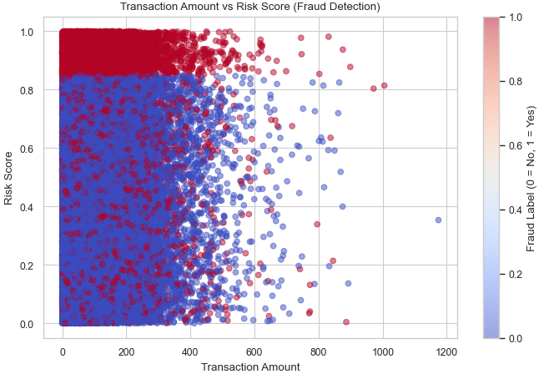

Slide 9
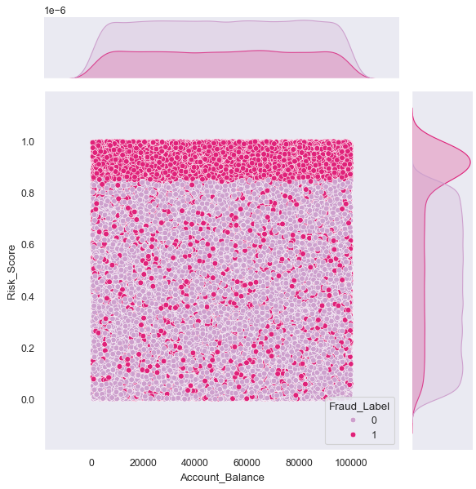

Slide 10
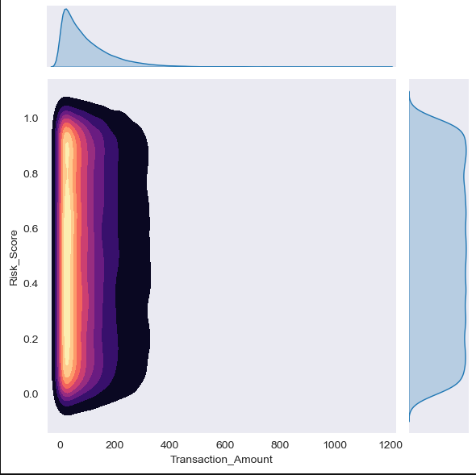

Slide 11
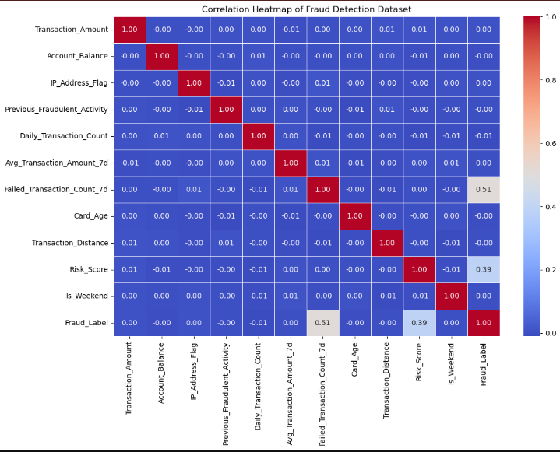

Slide 12
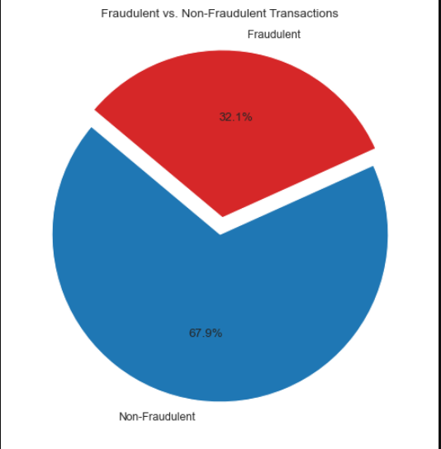

Slide 13
Github Link

Slide 14
Thank you!
Notes:
thank you very much for joining this PPT, keep learning.
14

